Slide 1

Lab 10

Slide 2
Lab Goal
For this lab you will be generating graphs to be used by a generic breadth-first search algorithm
The purpose of this lab is to show how breadth-first search can be used to find the shortest path between two points in a graph which can be used to solve various problems
The graphs that you will be generating will be for two different puzzles.
The Wolf, Goat, and Cabbage puzzle
Water Jugs puzzle

Slide 3
Important Provided Code Wolf Goat Cabbage Problem
In this problem state corresponds to an int
map<state, vector<state>> nbrs;
This is a map where the key is a state and the value is a vector of all the other states that are one action away from the given state
map<pair<state, state>, string> edge_label;
This is a map that contains a pair of two different states and a string that contains that action that was taken to get from the first state to the second state

Slide 4
Important Provided Code (Cont.) Wolf Goat Cabbage Problem
string neighbor_label(int s, int t);
This takes in two ints where s is the first state and t is the second state
This will generate a string that describes the action that was taken to get from state s to state t
const int wolf = 0, goat = 1, cabbage = 2, me = 3;
This line provides the values of each object that can cross the river
The values correspond to the bit each object references in a state

Slide 5
Important Provided Code Jugs Problem
In this problem state is a pair of ints where each int corresponds to the amount jug A and B contain
map<state, vector<state>> nbrs;
This is a map where the key is a state and the value is a vector of all the other states that are one action away from the given state
map<pair<state, state>, string> edge_label;
This is a map that contains a pair of two different states and a string that contains that action that was taken to get from the first state to the second state
const string actions[];
This is an array of strings that have the 6 different actions that can be taken

Slide 6
Code To Write
void build_graph(void)
This function needs to be written for both problems using their own unique implementations
This is responsible for filling in the nbrs and edge_label maps
To fill in the maps you will need to loop through each possible state and then generate each neighboring state
As you generate the neighboring states you should add each one to nbrs and edge_label maps

Slide 7
bitset
In the wolf/goat/cabbage problem there are 16 different states
Each bit in a state corresponds to whether something is on the left side of the river or the right side of the river
where 0 = left and 1 = right
The bitset is a class in c++ that could be helpful for this portion of the assignment as it allows for easy manipulation of bits in numbers
It is not required to use this class, so if you do not want to use it that is fine

Slide 8
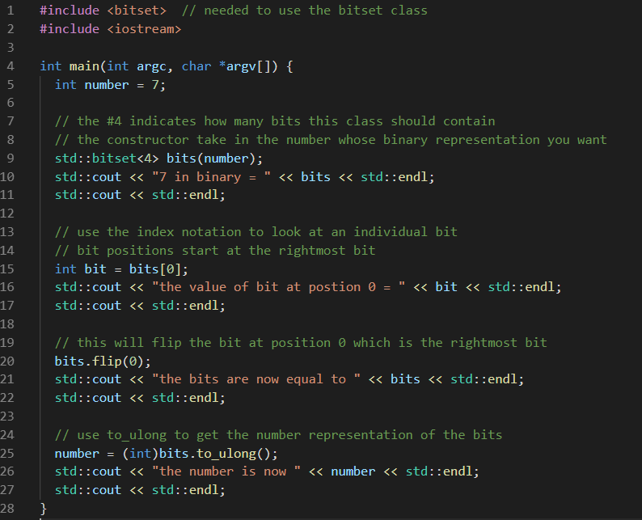
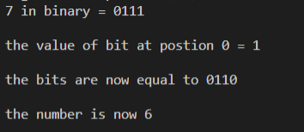
Bitset example

Slide 9
Example Wolf Goat Cabbage
There are always 4 different actions that can be done at each state
Person crosses river with wolf
Person crosses river with goat
Person crosses river with cabbage
Person crosses river alone
The person can only cross the river with something if that thing is on the same side of the river as the person
Also if a state results in bad things happening (goat and wolf on one side without the person or goat and cabbage on one side without the person) then we want to ignore that state

Slide 10
Example Wolf Goat Cabbage (cont.)
nbrs = {}
edge_label = {}
Current_state = 0 = 0000
Integer Values (bit locations from right to left)
wolf = 0, goat = 1, cabbage = 2, me = 3
Action | New state (binary) | New State (number) | Good/Bad State
Person crosses river with wolf | 1001 | 9 | Bad (goat with cabbage unsupervised)
Person crosses river with goat | 1010 | 10 | Good
Person crosses river with cabbage | 1100 | 12 | Bad (wolf with goat unsupervised)
Person crosses river alone | 1000 | 8 | Bad (goat with cabbage unsupervised and wolf with goat unsupervised)

Slide 11
Example Wolf Goat Cabbage (cont.)
Action | New state (binary) | New State (number) | Good/Bad State
Person crosses river with wolf | 1001 | 9 | Bad (goat with cabbage unsupervised)
Person crosses river with goat | 1010 | 10 | Good
Person crosses river with cabbage | 1100 | 12 | Bad (wolf with goat unsupervised)
Person crosses river alone | 1000 | 8 | Bad (goat with cabbage unsupervised and wolf with goat unsupervised)
We now add the neighboring states of state 0. Remember we only add states that are good
nbrs = {0-> {10}}
edge_label = {(0,10)->“Cross with goat”}
Green = key
Purple = value

Slide 12
Example Water Jugs
There are always 6 different actions that can be done at each state
Fill A
Fill B
Empty A
Empty B
Pour A into B
Pour B into A

Slide 13
Example Water Jugs (cont.)
nbrs = {}
edge_label = {}
Current_state = (1,3)
Jug A has 1 unit of water and Jug B has 3 units
Action | New State
Fill A | (3,3)
Fill B | (1,4)
Empty A | (0,3)
Empty B | (1,0)
Pour A into B | (0,4)
Pour B into A | (3,1)

Slide 14
Example Water Jugs (cont.)
Action | New State
Fill A | (3,3)
Fill B | (1,4)
Empty A | (0,3)
Empty B | (1,0)
Pour A into B | (0,4)
Pour B into A | (3,1)
We can now add the neighboring states of (1,3)
nbrs = {(1,3)-> {(3,3)(1,4),(0,3),(1,0),(0,4),(3,1)}}
edge_label = { ((1,3),(3,3))-> “Fill A” ; ((1,3),(1,4))-> “Fill B” ; ((1,3),(0,3))-> “Empty A” ; ((1,3),(1,0))-> “Empty B” ; ((1,3),(0,4))-> “Pour A->B” ; ((1,3),(3,1))-> “Pour B->A” }
Green = key
Purple = value

Slide 15
Some Notes
To make a pair of something you can use the function make_pair(object1, object2)
To add a new value to a vector in a map use the following notation
some_map[key].push_back(value)
Using the above notation will automatically check to see if the key exists in the map. If the key is not in the map it will automatically add the key and set the value to an empty vector

